Slide 1
Integrating the Military Instrument to enhance social resilience
Assess the utility and limitations of the military as an instrument of national power in addressing non-traditional national security threats in concert with other instruments available to states.
Comdt Adam Beatty, Comdt Sinead Doyle, Maj Romin Poussonn
23 October 2025

Slide 2
Presentation Structure
BLUF
Sinéad
The problem
Theoretical context
Context case study
Adam
Organisational adaptation effect
Resilience synergy effect
Romin
Cyber and disinformation
Ireland and US case studies
Conclusion

Slide 3
BLUF
In a national context, Security is NOT just about military threats. (Finnegan 2025)
Nations use the concept of SECURITISATION to transform some non traditional threats into matters of security. (Finnegan 2025)
A nation will utilise all available instruments of national power to address national security threats (DIME)
Values – Cost = Utility of the military instrument. (Maxwell 2025)

Slide 4
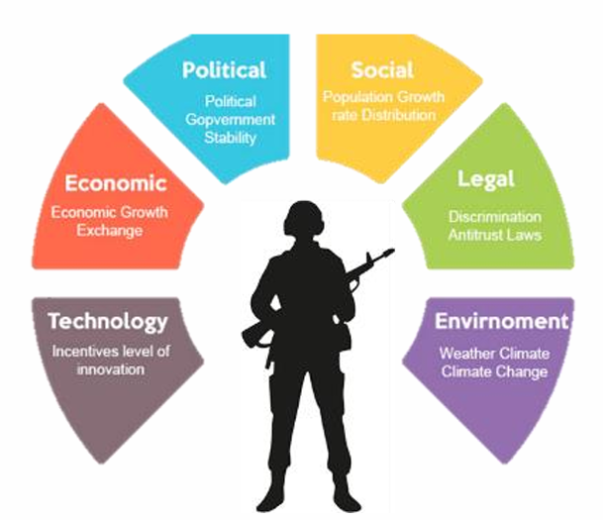

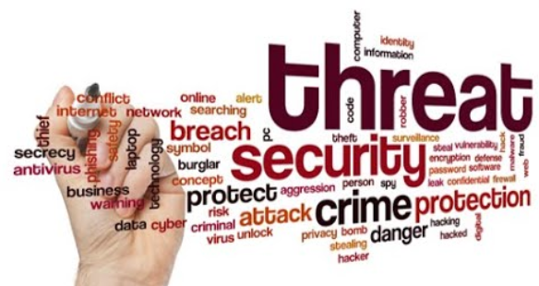

Define the Problem
(Vincent, 2025)
Instruments of National Power
(Khattak, 2025)
Non traditional national security threats
(Rohan et al, 2013)
Societal Resilience
(DF Leadership Doctrine, 2023)
Military Instrument
What service does the military instrument provide to the people of the State?

Slide 5
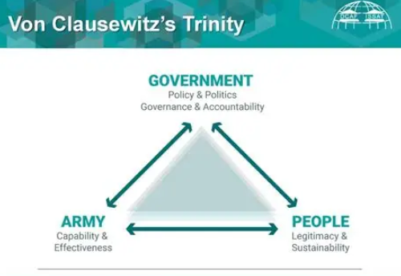
Theoretical Context
National power
(Ways)
Military instrument
(Means)
Societal resilience
(Ends)
Slideplayer (2024)

Slide 6
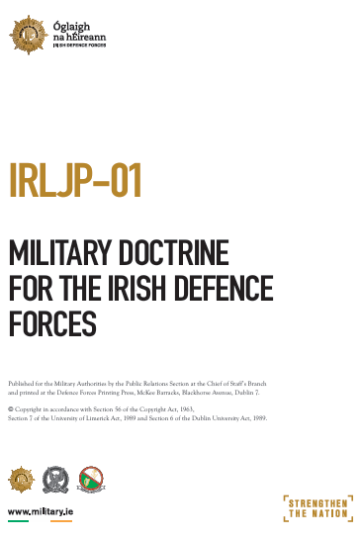
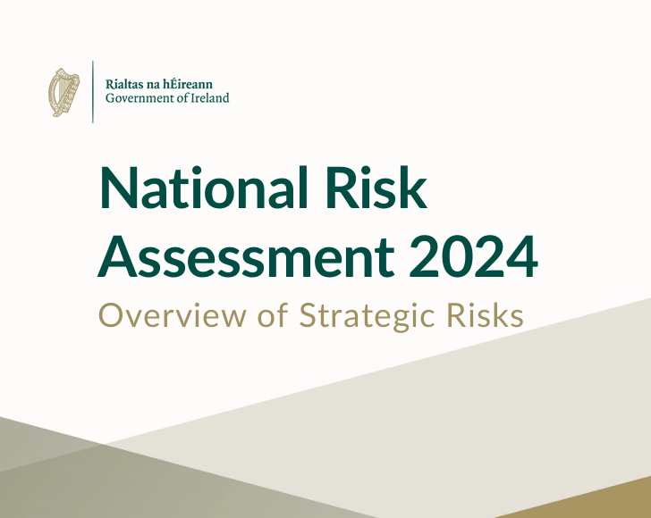
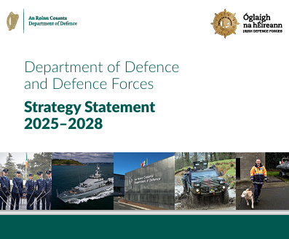
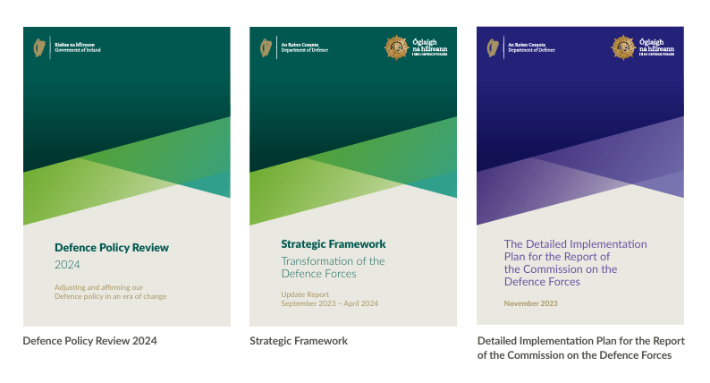
The Context Case Study - Ireland
Identifying non traditional
security threats

Slide 7
The Context Case Study
Political factors
National risk assessment
Defence strategy
Ethical factors
Perceived Societal value
Non traditional
security threats
SUCCESSFUL utility of the military instrument
Irelands critical infrastructure
Logistical factors
EEZ size
Maritime capabilities
Strategic factors
International alliances
Societal resilience

Slide 8
The Context Case Study
Political factors
Government response
NPHET
Ethical factors
Restrictions
Care homes
Deaths & funerals
Non traditional
security threats
LIMITED
utility of the military instrument
Pandemic & health security
Logistical factors
COVID tests
Contacting tracing
Testing centres
Strategic factors
Societal resilience

Slide 9
The "So What"
What service does the military provide to the people of the State?
Provides the military instrument of national power for the people of the State
Values – Cost = Utility of the military instrument. (Maxwell 2025)

Slide 10
References
Department of Defence and Defence Forces (2025). Department of Defence and Defence Forces Strategy Statement 2025-2028. Ireland. Available at: https://assets.gov.ie/static/documents/department-of-defence-and-defence-forces-strategy-statement-2023-2026.pdf
Finnegan, R. (2025) Constructivism and Securitization, Lecture notes distributed in HY672M: Defence and Strategic Studies. 24 Sept 2025, Maynooth University.
Government of Ireland (2024). National Risk Assessment 2024. Ireland. Available at: https://assets.gov.ie/static/documents/national-risk-assessment-2024-overview-of-strategic-risks.pdf
Irish Defence Forces (2023) DF Leadership Doctrine. Chief of Staffs branch: Defence Forces Printing Press.
Khattak, M. (2025) The concept of security in the 21st century: Traditional and non traditional approaches to security. [online image]. Available at: https://i.ytimg.com/vi/iVFonewq9e4/maxresdefault.jpg (Accessed 29 Sept 25)
Maxwell, J. (2025) Power, Security and the Use of Force, Lecture notes distributed in HY672M: Defence and Strategic Studies. 01 Oct 2025, Maynooth University.
Mullins, L. J. (2005). Management and organisational behaviour (7th edn.). Essex. Prentice Hall Financial Times.
Rohan, G., Jolene, J. and Salim, MN. (2013) Countering Extremism: Building Social Resilience Through Community Engagement. London: Imperial College Press.
Slideplayer, (2024). Defence Sector Transformation. [online image]. Available at: https://www.bing.com/images/search?view=detailV2&ccid=marBLnXT&id=37D217FA80306623EB97EF31B65FF1932C25536F&thid=OIP.marBLnXT1y2Kxh2hdDTLqwHaFj&mediaurl=https%3A%2F%2Fslideplayer.com%2Fslide%2F13754699%2F85%2Fimages%2F9%2FVon%2BClausewitz’s%2BTrinity.jpg&cdnurl=https%3A%2F%2Fth.bing.com%2Fth%2Fid%2FR.99aac12e75d3d72d8ac61da17434cbab%3Frik%3Db1MlLJPxX7Yx7w%26pid%3DImgRaw%26r%3D0&exph=768&expw=1024&q=Clausewitz+Trinity+of+War&form=IRPRST&ck=414176EB5743D89215738A200A90D954&selectedindex=0&itb=0&cw=1145&ch=535&ajaxhist=0&ajaxserp=0&vt=0&sim=11 (Accessed 30 Sept 25)
Vincent, D. (2025) Strategic Context, Lecture notes distributed in HY671M: Command, Leadership and Management. 09 Sept 2025, Maynooth University.

